Slide 1


Walmart Sales & Customer
Insights Analysis

Slide 2
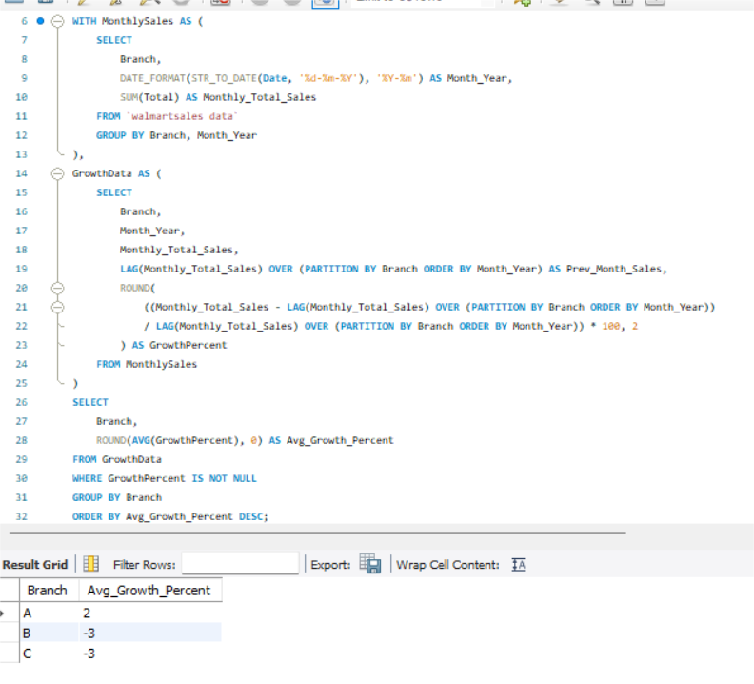

Task : 1
Identifying the Top Branch by
Sales Growth Rate
Analysis
Branch A showed a positive
average growth rate of +2%,
making it the top-performing
branch in terms of month-on-month
sales expansion.
Branches B and C both experienced
a negative average growth rate of -
3%, indicating a consistent decline
in sales over the period.

Slide 3
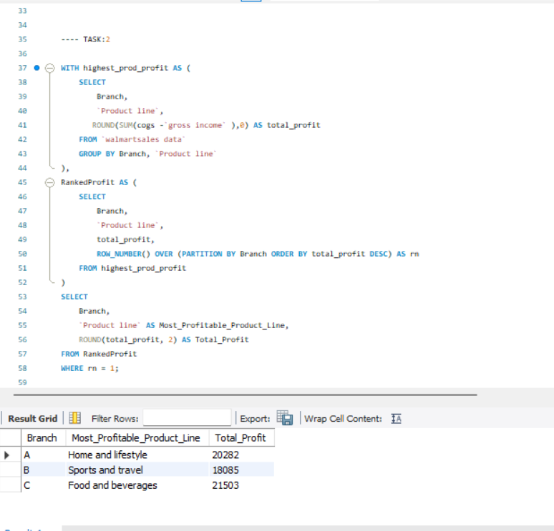
Task: 2
Finding the Most Profitable Product Line for Each Branch
Analysis
Branch A: Highest profit from Home
and Lifestyle
Branch B: Most profit from Sports
and Travel
Branch C: Top earnings from Food
and Beverages

Slide 4
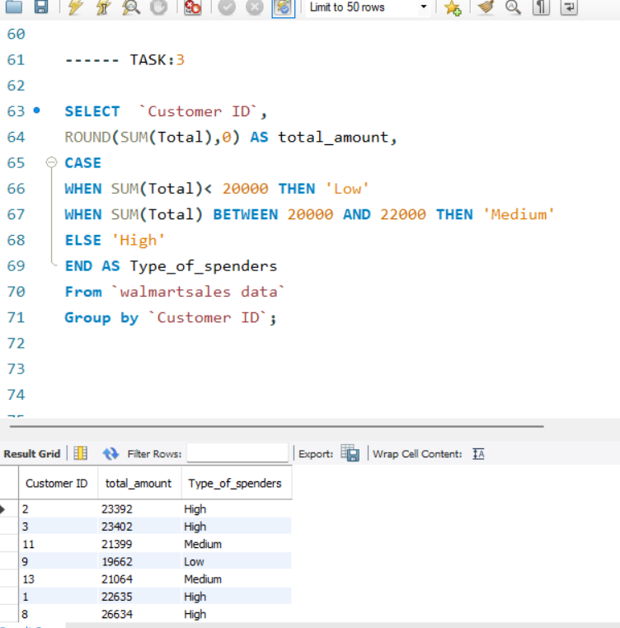
Task: 3
Analyzing Customer Segmentation Based on Spending
Analysis
Walmart segmented customers based on
total spending:
High Spenders (> ₹22,000): Strong loyal buyers
Medium Spenders (₹20,000– ₹22,000): Consistent shoppers
Low Spenders (< ₹20,000): Casual
or occasional buyers

Slide 5
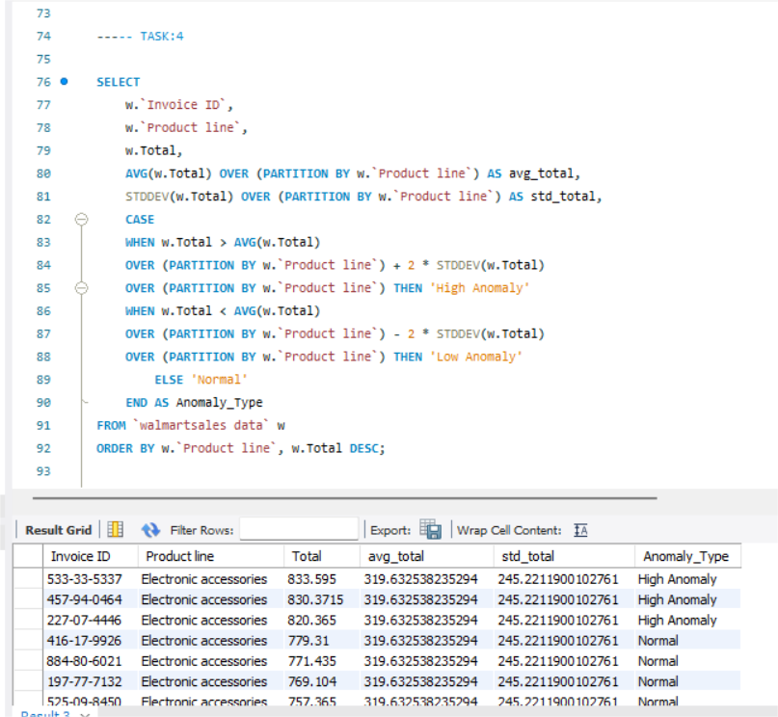
Task: 4
Detecting Anomalies In Sales
Transactions
Analysis
To identify unusual transactions (extremely high or very low totals) inside each product, Walmart examined sales data.
Line using ±2 standard deviations from the mean, which are statistical thresholds.
Unusually significant purchases were identified as "High Anomaly" in certain transactions.
Some purchases were classified as "Low Anomaly," meaning they were abnormally low.

Slide 6
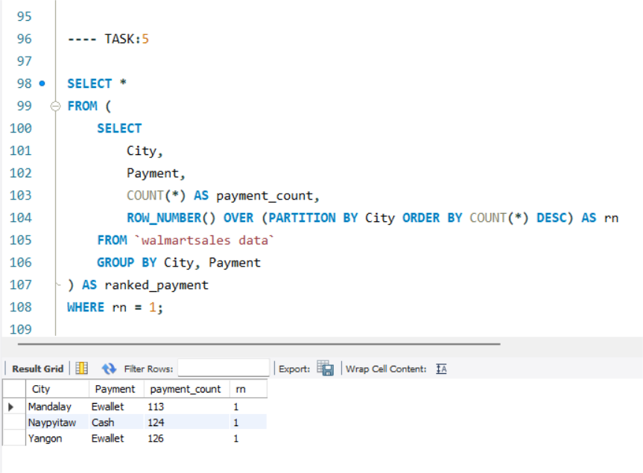
Task: 5
Most Popular Payment Methods
By City
Analysis
Payments via eWallet are preferred in Mandalay and Yangon.
The preference of Naypyitaw is Cash.
Greater digital usage is seen in Mandalay and Yangon, where there is a considerable preference for e-wallets.
The Naypyitaw still depends on cash.

Slide 7
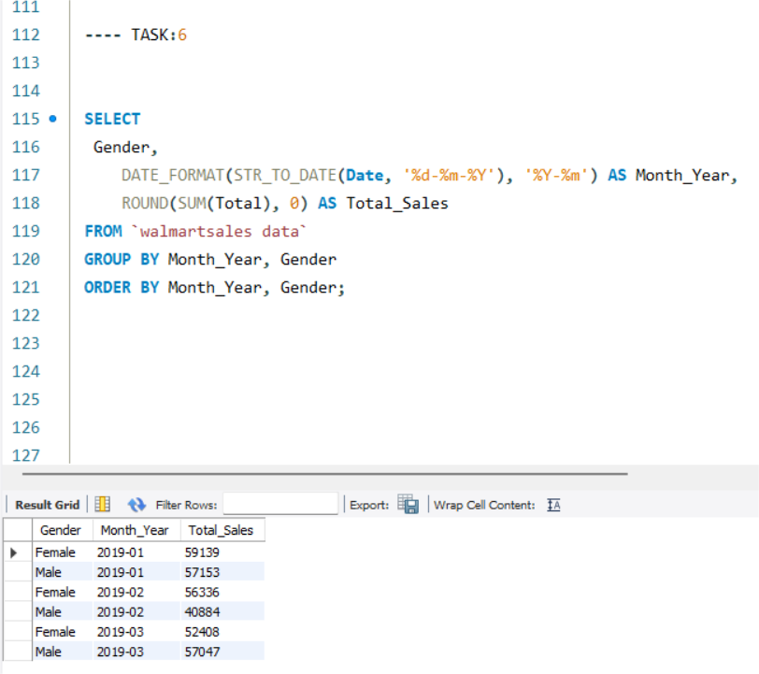
Task: 6
Monthly Sales Distribution
By Gender
Analysis
Monthly spending by female clients was consistently higher than that of male customers.
January 2019: Male: 57,153 | Female: 59,139
February 2019: Males: 40,884 | Female: 56,336
March 2019: Male: 57,047 | Female: 52,408

Slide 8
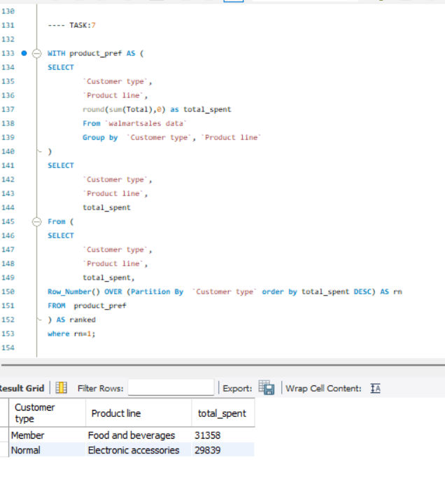
Task: 7
Best Product Line by
Customer Type
Analysis
For each category of consumer (Member vs. Normal), the query determines which product line generates the highest revenue.
It ranks product lines by total revenue within each client group using SUM(Total).
For every type, only the top product line is displayed.

Slide 9
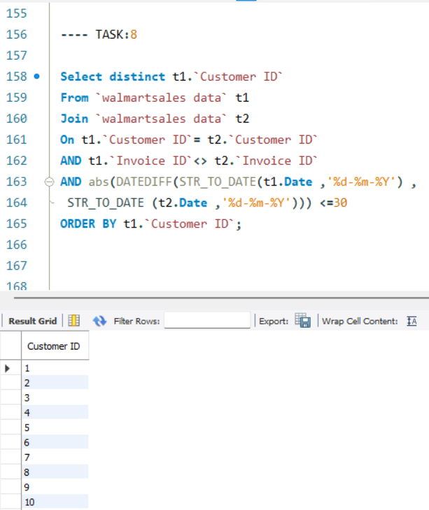
Task: 8
Identifying Repeat Customers
Analysis
Repeat customers are listed in the query, arranged by frequency of purchases. The discovery of 15 repeat customers in a 30-day span suggests a group of very interested and devoted customers who come back regularly, indicating high levels of satisfaction with Walmart's offerings, costs, or customer service.

Slide 10
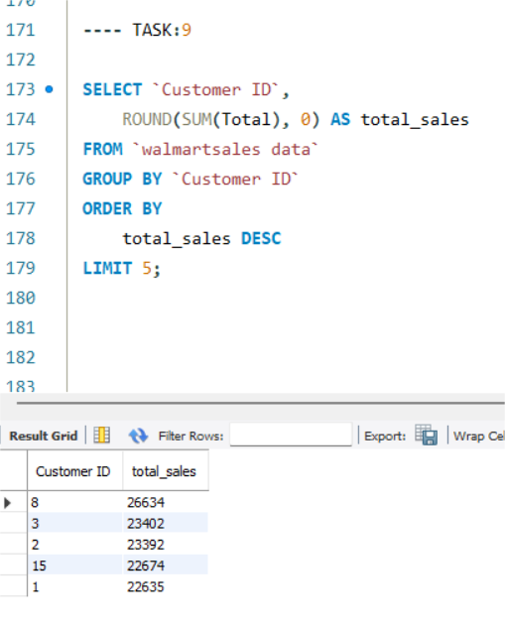
Task: 9
Finding Top 5 Customers by
Sales Volume
Analysis
Each Customer ID's total sales (SUM(Total)) are calculated, and the top 5 customers who have produced the most sales revenue are chosen after they are ranked in descending order of revenue.
These consumers are Walmart's biggest sources of income, thus they should be given special attention, loyalty benefits, and tailored advertising campaigns.
Ask ChatGPT

Slide 11
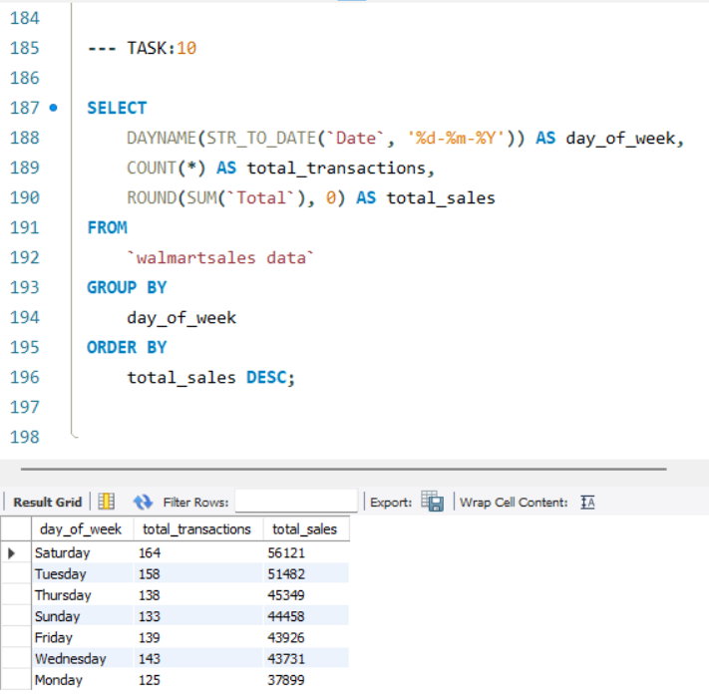
Task: 10
Analyzing Sales Trends by
Day of the Week
Analysis
The day (such as Monday or Tuesday) from the invoice date is extracted by the query using DAYNAME().
It then:
Determines the daily sales total.
Adds up all of the revenue.
The results are arranged in descending order by total sales.

Slide 12
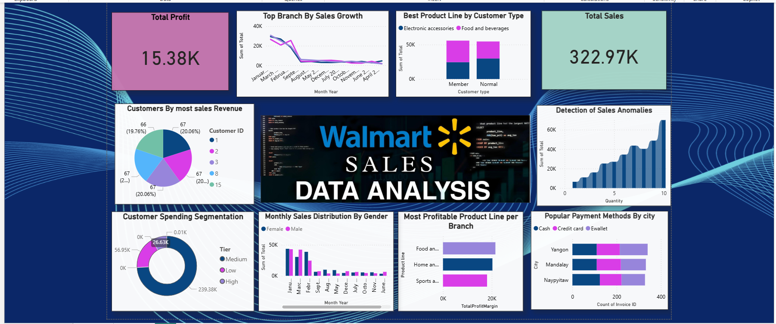
Walmart Sales Analysis

Slide 13
Thank
You.
BY RASHI SINGH

